Slide 1

RFM
Team-6
Ganesh Swaminathan K Balu Kiran Bokka Sampreethi Bokka Vooha Lavu Pratham Sagar Jalindre

Slide 2
Customer Dimension
Aggregated Facts as Attributes
RFM Analysis
Customer-centric dates
Outrigger dimension

Slide 3
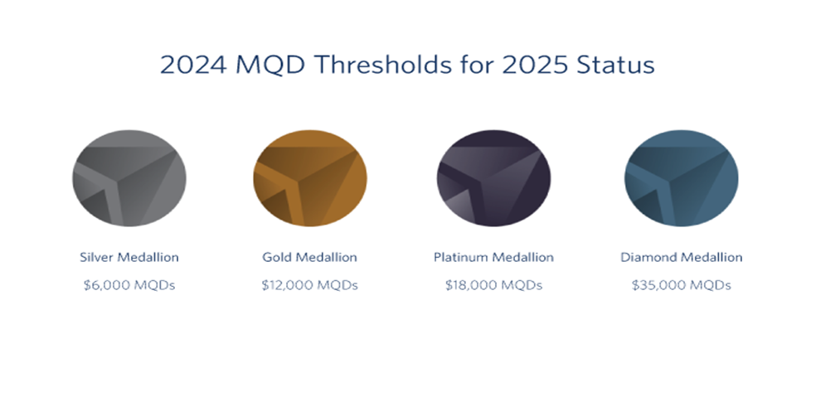
Aggregated Facts as Attributes
•Calculated characteristics based on accumulated historical data (e.g., loyalty tier, purchase frequency)
•Loyalty Tiers in Airlines: Silver, Gold, and Platinum based on cumulative flight activity

Slide 4
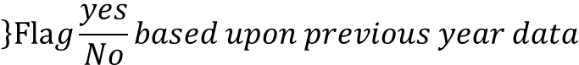
Aggregated Facts as Attributes
CustmerID | CustomerName | PhoneNum | ZipCode | State | Gender
10001 | Steven | 3265656446 | 75254 | Texas | M
10002 | Elizabeth | 3121111631 | 75252 | Texas | F
10003 | Tony | 2255997763 | 71236 | Texas | M
10004 | Richard | 6558841233 | 73215 | Texas | M
10005 | Peter | 2994698989 | 71564 | Texas | M
TopCustomer
N
Y
Y
N
N
$$\left\}Fla\right.g\frac{yes}{No}based upon previous year data$$
Aggregated Facts as Attribute
Normal Attributes

Slide 5
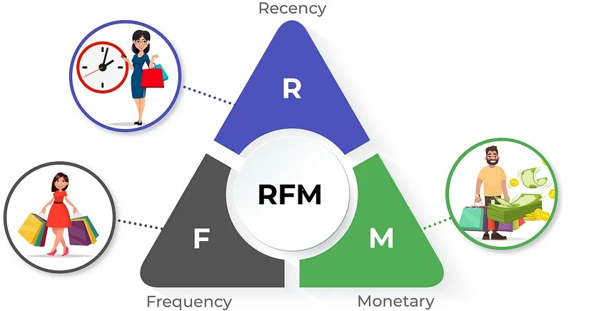
RFM Analysis
To understand the customer behavior, many companies employ RFM (Recency, Frequency, Monetary) analysis. Each dimension helps businesses classify customers by analysing when and how often they buy, as well as their spending patterns.

Slide 6
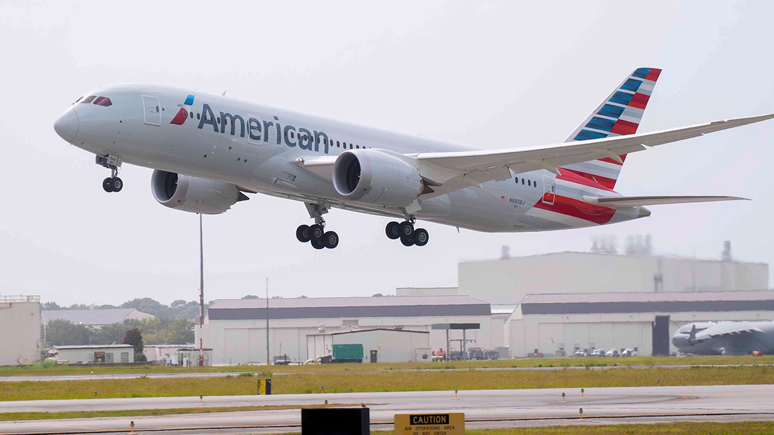
Recency (R)
Recency measures how recently a customer made a purchase
Recency Varies by Business
For an airline, a customer who flew this quarter may be considered recent

Slide 7

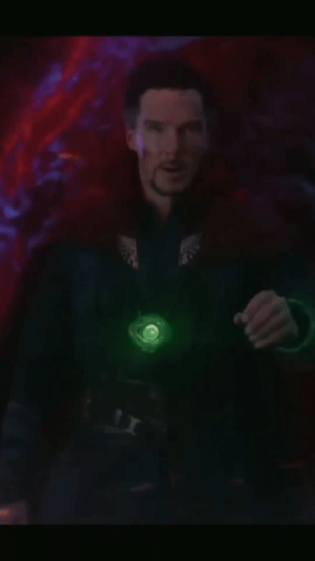
Frequency (F)
Frequency evaluates how often a customer makes purchases within a specific period

Slide 8


Monetary (M)
The monetary dimension reflects customer spending levels, showing whether a customer is valuable due to high spending, even if they buy infrequently

Slide 9
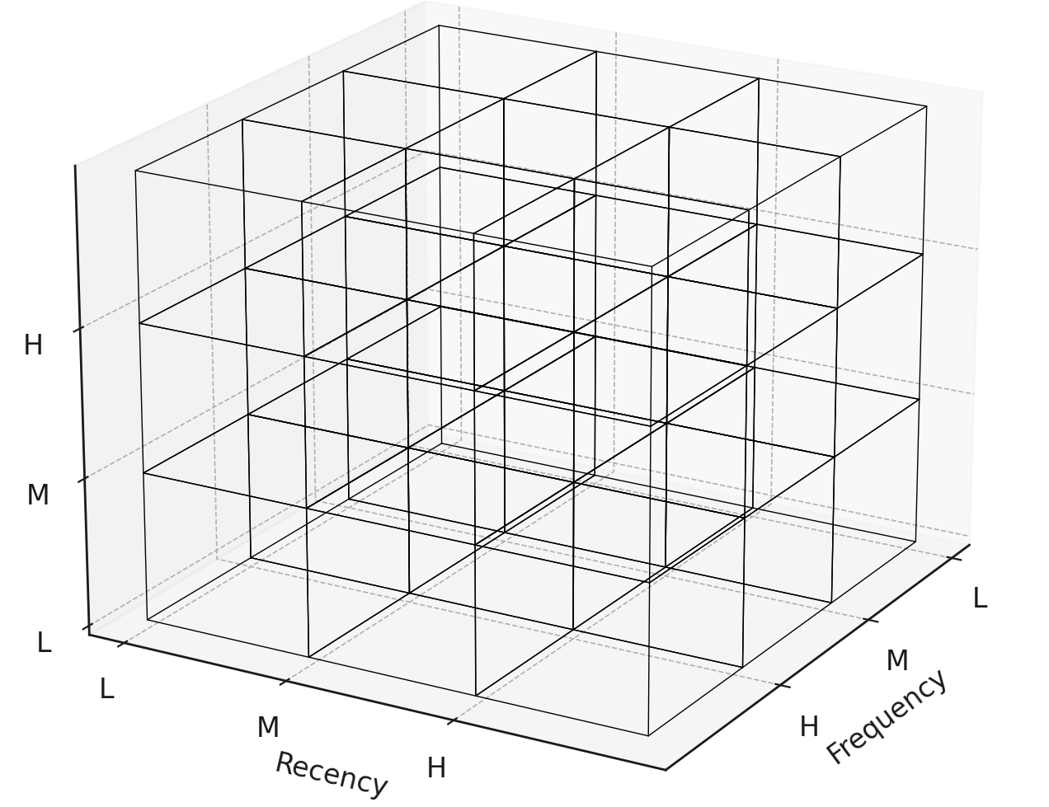
Here L – Low ,M – Medium, H – High
Shorthand
LLL – A
LLM – B
…
…
HHH – Z
Monetary

Slide 10

RFM Trajectory

Slide 11
RFM Trajectory
CustmerID | CustomerName | PhoneNum | ZipCode | State | Gender
10001 | Steven | 3265656446 | 75254 | Texas | M
10002 | Elizabeth | 3121111631 | 75252 | Texas | F
10003 | Tony | 2255997763 | 71236 | Texas | M
10004 | Richard | 6558841233 | 73215 | Texas | M
10005 | Peter | 2994698989 | 71564 | Texas | M
RFM Trajectory
YXBCPPQQQX
XBCPPQQQXQ
WXPPFBFRTTD
SSFGGLLRFQE
FFREFELFIJEJF
Customer’s journey in last 10 quarters

Slide 12

QUIZ
Question:
The RFM trajectory string for each customer is updated quarterly, retaining the last ten quarters. What type of Slowly Changing Dimensions (SCD) is this?
A) Type 2
B) Type 3
C) Type 4
D) Type 1

Slide 13

Introduction to customer-centric dates

Slide 14

The Challenge of Wide Customer Dimension Tables
Multiple Date Attributes
Customer profiles often include numerous date-related fields, such as account creation, birthday, marriage anniversary, graduation date, etc.
Expanded Date Information
Each date requires additional columns for month, quarter, and year information
Table Width Issues
With many date attributes, customer dimension tables can become excessively wide, impacting performance

Slide 15
•By snowflaking the date attributes
•Snowflaking is to cut the width of the customer table
•Each of this separate date tables is called date outrigger

Slide 16
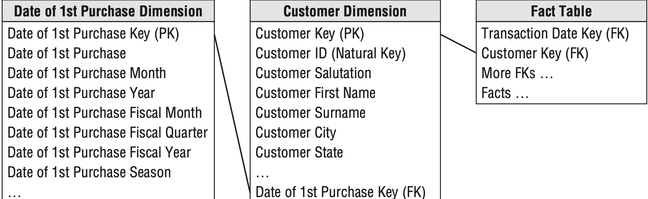
Date Outrigger
Example

Slide 17
QUIZ
Question:
Each date outrigger is essentially a _________ .
A) Mini Dimension
B) Role-Playing Dimension
C) Conformed Dimension
D) Junk Dimension

Slide 18

Thank you
Notes:
A well-maintained customer dimension is crucial for effective CRM analysis, but large organizations face challenges due to size and complexity. Customer dimensions can include dates, aggregated facts, segmentation attributes, and behavior tags, which can be stored in separate tables for complex querying and improved performance.

